Slide 1

Jigsaw Comments Classification
Dave Wei

Slide 2
Why Should We Do This?
Improve User Experience / Customer Stickiness
Help Online Discussion Become More Productive and Respectful
Reduce the Need for Human Labor

Slide 3
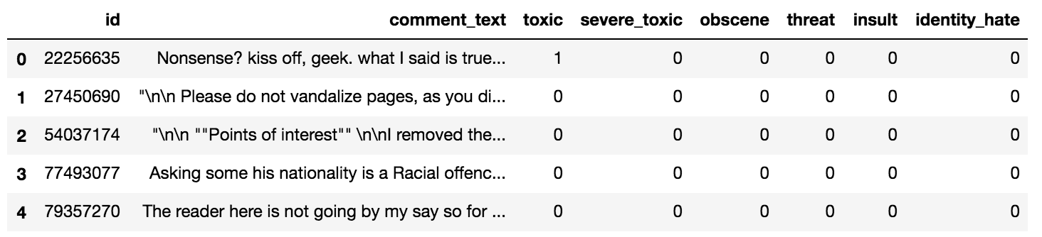
A Glimpse into Our Data
Train.csv

Slide 4
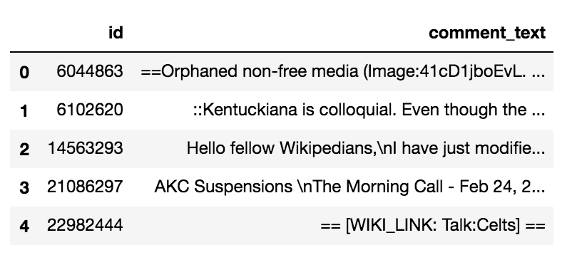
A Glimpse into Our Data
Test.csv

Slide 5
Statistics
Data Split
Number of training data : 95851
Number of testing data : 226998
Training data : testing data = 3 : 7
Missing Value
Only found one in testing dataset

Slide 6
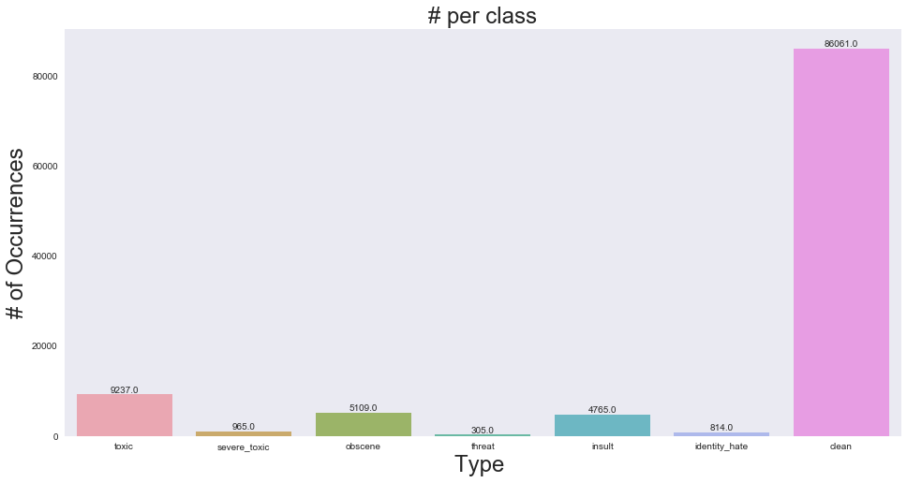
Statistics
Class Imbalance
Total: 95851
Clean: 86061
Type: 21195

Slide 7
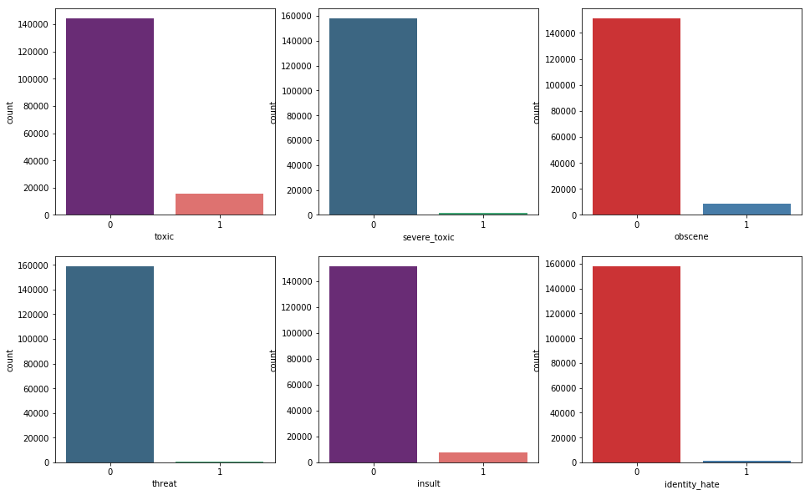
Statistics
Class Imbalance

Slide 8
Statistics
Crosstab
 | severe_toxic |  | obscene |  | threat |  | insult |  | identity_hate
Toxic | 1 | 0 | 1 | 0 | 1 | 0 | 1 | 0 | 1 | 0
1 | 86614 | 0 | 86302 | 312 | 86598 | 16 | 86294 | 320 | 86551 | 63
0 | 8272 | 965 | 4440 | 4797 | 8948 | 289 | 4792 | 4445 | 8486 | 751

Slide 9
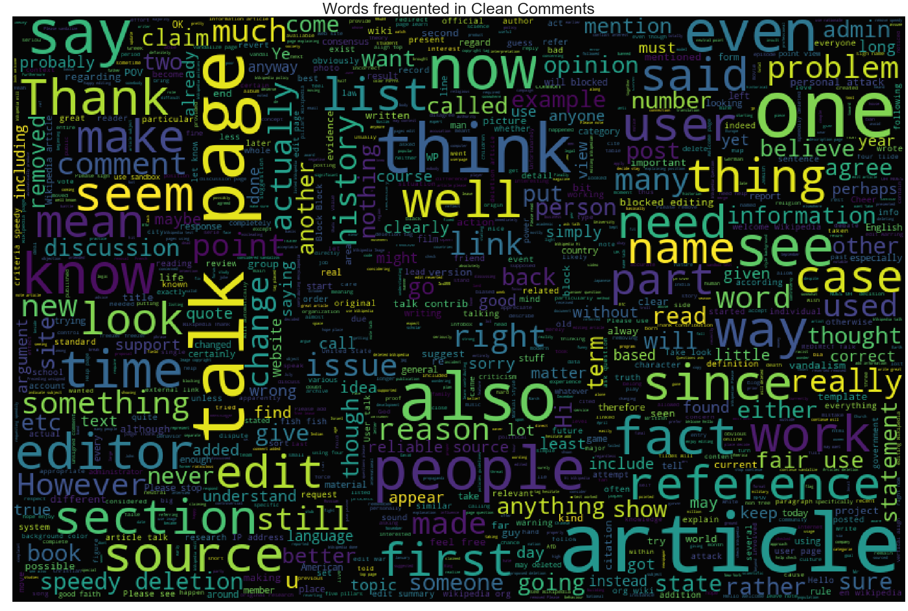
Word Cloud
Clean comments

Slide 10

Clean comments

Slide 11
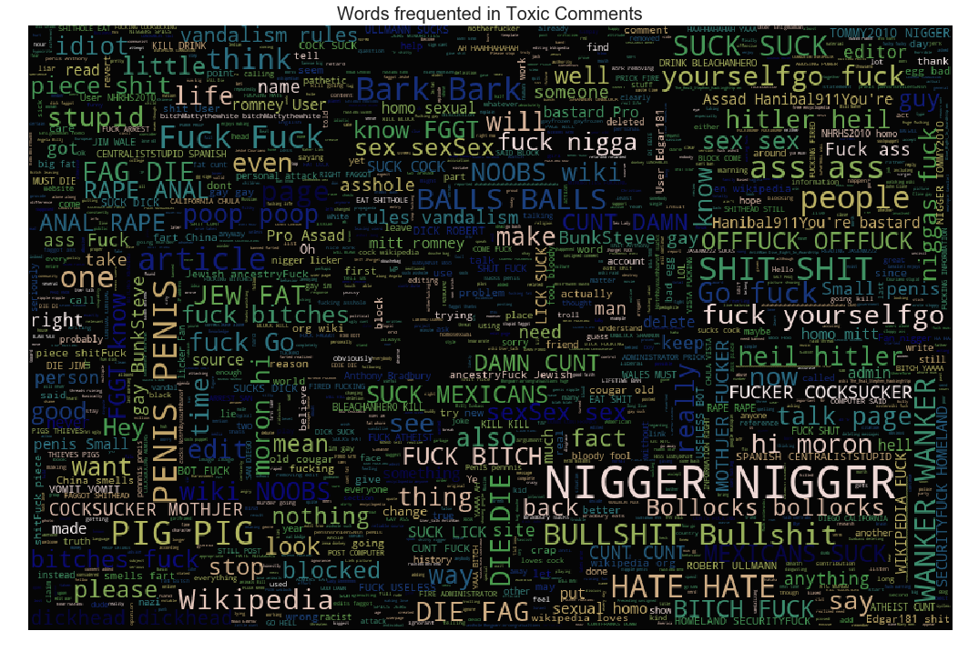
Word Cloud
Clean comments

Slide 12
Classification
TF-IDF + Logistic Regression
Toxic ROC AUC: 0.9848232752849416 Severe_toxic ROC AUC: 0.9921745527411732 Obscene ROC AUC: 0.9935666730984923 Threat ROC AUC: 0.9944880553629133 Insult ROC AUC: 0.9879963066164954 Identity_hate ROC AUC: 0.9897514246294196

Slide 17
Features
How usually do people express their anger?
Number/portion of capitals - observation was many toxic comments being ALL CAPS
Number of exclamation marks - i observed several toxic comments with multiple exclamation marks
Number of symbols/punctuations - assumtion that words like fck or $# or sh*t mean more symbols in foul language
Number of unique words - observation that angry comments are sometimes repeated many times
Number of (happy) smilies - Angry people wouldn't use happy smilies (Sarcasm?)

